Slide 1
Measurement of position using Hall effect sensors

Slide 2
Hall effect
The Hall effect is the production of a voltage difference (the Hall voltage) across an electrical conductor that is transverse to an electric current in the conductor and to an applied magnetic field perpendicular to the current.
It was discovered by Edwin Hall in 1879.
The magnitude of the voltage depends upon the current, the strength of magnetic field and the property of conductor.
Hall effect can be in conductor and semiconductor in varying amount and will depend upon the densities and mobility of carriers.
The Hall Effect occurs when a current flowing in a carrier (semiconductor) experiences a magnetic field perpendicular to the direction of the current flow.
The interaction between the two causes the current to be deflected perpendicular to the direction of both the magnetic field and the current

Slide 3
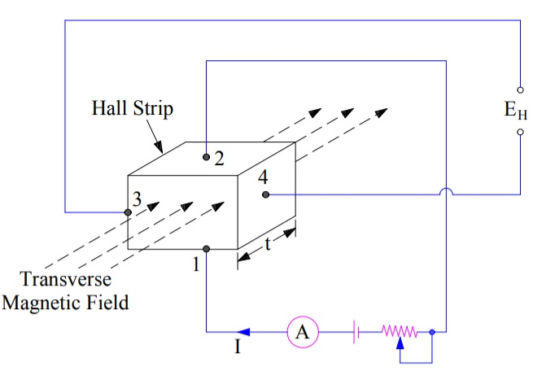
Hall effect

Slide 4
Materials
The key factor determining sensitivity of Hall effect sensors is high electron mobility. As a result, the following materials are especially suitable for Hall effect sensors.
gallium arsenide(GaAs),
indium arsenide (InAs),
indium phosphide (InP),
indium antimonide (InSb),
graphene.

Slide 5
Applications
Measurement of Magnetic Field Strength
Measurement of Displacement.
Measurement of Current
Position sensing
Direct-current Measurements.
Automotive fuel-level indicator
Keyboard switch

Slide 6
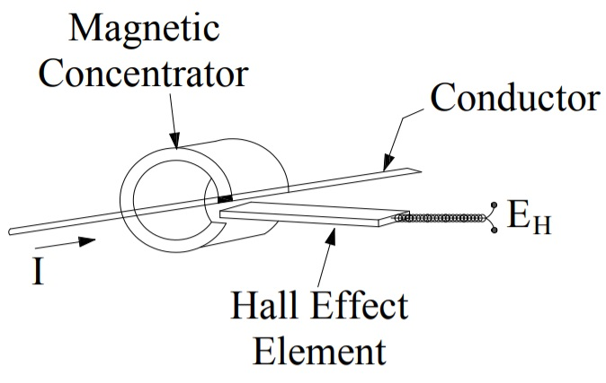
Hall effect(Measurement of Current)

Slide 7
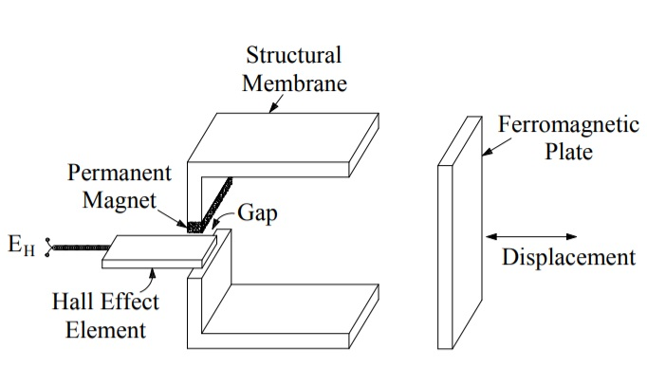
Hall effect(Position Sensing)

Slide 8
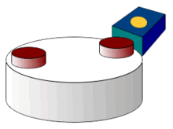
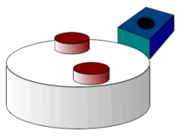
Hall effect(Position Sensing)

Slide 9
Advantages and Disadvantages
Advantages
Hall sensors are capable of measuring a wide range of magnetic fields
They are sensitive to both the magnitude and orientation of the field.
When used as electronic switches, they are less prone to mechanical failure, since there is no wear on physical parts.
They can also be operated at higher frequencies than mechanical switches.
Disadvantages
Hall effect switches cannot be used in areas with high external magnetic fields.
Hall sensors can be prone to thermal drift due to changes in environmental conditions,
Hall sensors can be prone to time drift over the lifetime of the sensor

